Slide 1




R bius
Seamless Multi-Platform App Development in Rust
Kevin Boos Principal Architect, Futurewei
May 8th, 2024

Slide 2

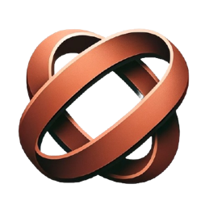

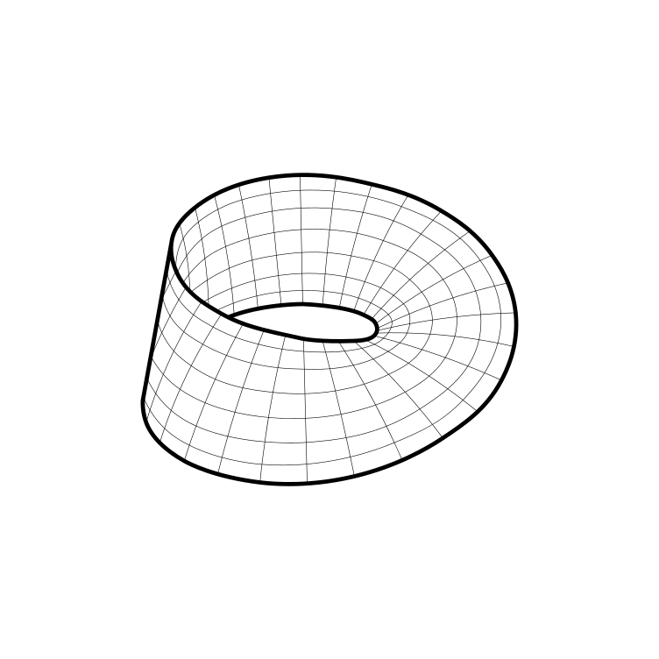
Robius at a glance
Create a multi-platform app dev experience fully in Rust
leverage the robust, safe, and performant Rust ecosystem
avoid dealing with multiple languages/environments
never write a single line of platform-specific code
Make Mobile a first-class concern in the Rust community
The Rust experience on Mobile feels neglected
Devs can:
Notes:
Robius strives to do to main things

Slide 3
Background: Project Robius
Fully open-source, decentralized, and community-driven
Independent collaborators across US, Europe, Aus/NZ, S. America, China
All components written entirely in Rust
But why Robius? … there are tons of great Rust UI toolkits out there
egui, Iced, Slint, Tauri, Leptos, Dioxus, Makepad, Xilem, Freya, Ribir, …
→ There’s way more to app dev than just drawing a GUI!
Many existing Rust apps are “less Rust, more other code”
Big platform-specific wrappers around a small Rust core
Notes:
There are quite a few projects that experiment with how to build a great GUI using Rust; Dioxus, tauri, makepad, Xilem and the linebender project, etc. But to build a fully-featured app these days, you need an awful lot more than just UI and basic input events. That's what Project Robius is all about: we leave UI design to the experts, and step in to fill the gaps everywhere else in the app dev environment. This includes everything from complex build systems, support for platform-specific APIs and OS services (with nice Rust abstractions for each class of functionality), signing/packaging/bundling/distributing apps, and more. Everything is entirely open-source and decentralized. Nothing is owned or controlled by one party, and we welcome contributions from anyone and everyone.

Slide 4
Motivation

Slide 5
What motivates our work?
App devs want to use Rust, but aren’t sure where/how to start
Paralysis of choice among many offerings
Unclear how to integrate a bunch of independent projects
Clear business advantages
Consistent multi-platform experience for devs and customers
Avoid redundant dev effort → save money, faster time to market
Rust is great! (not for cross-platform apps, yet)
Safety → increased correctness, reliability
Performance efficiency → responsive, jank-free UI
Potential to unify two dev worlds: systems + frontend apps
→ Attract front-end devs to the world of Rust (and vice versa)
Notes:
Unclear integration opportunities
Which crates work with which others?
Poor documentation; lack of examples, tutorials
Business case/perspective – why is this needed?
Evidence – why was Flutter created?
Rust offers safety and performance
Safety leads to increased correctness, eliminating memory & concurrency bugs
Higher reliability, less developer frustration and debugging difficulties
Amenable to formal verification and type-carried invariants
Less runtime overhead via static (compile-time) checking and guarantees
Focus on zero-cost abstractions (e.g., async state machines)
No garbage collection, static memory lifetime analysis
Monomorphization of generics
const eval, etc
Interactive systems, especially mobile, require good performance and efficiency; achievable with Rust
Performance is key for a smooth, responsive UI without jank
Efficiency is key for longer battery life, less heat output
Built-in support for easy cross-platform compilation targeting
Good, clear dependency management via cargo

Slide 6
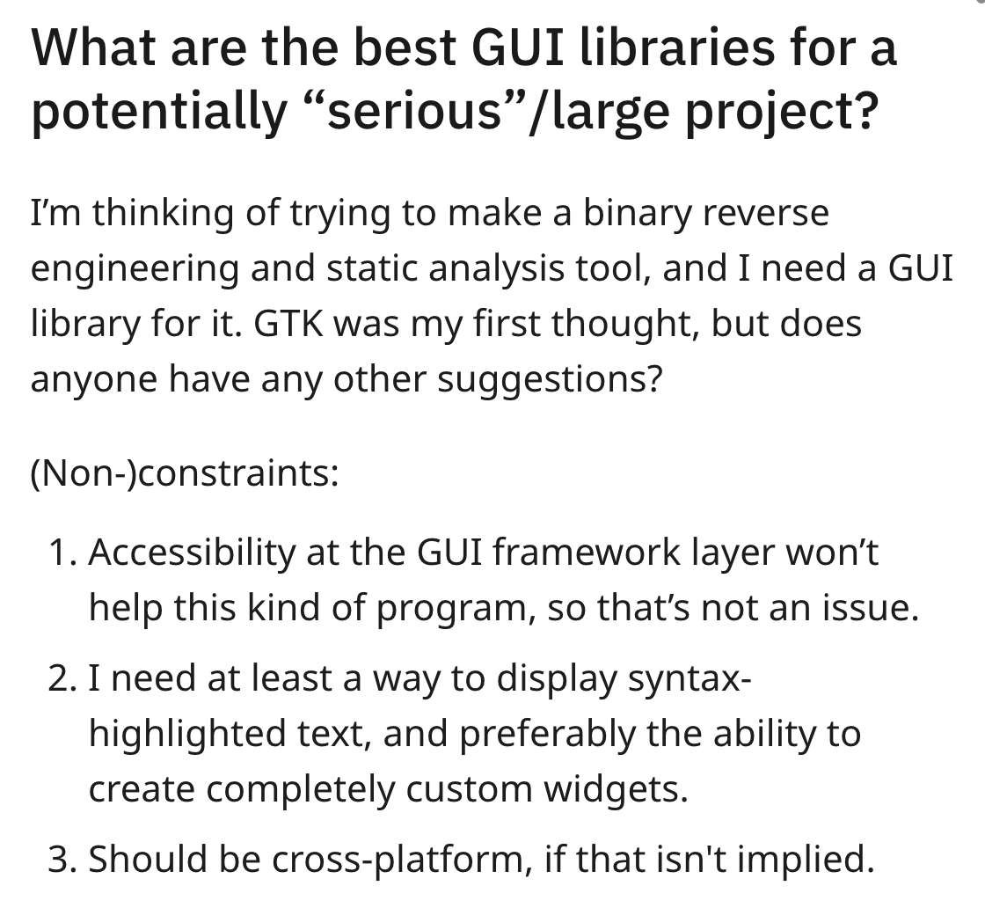
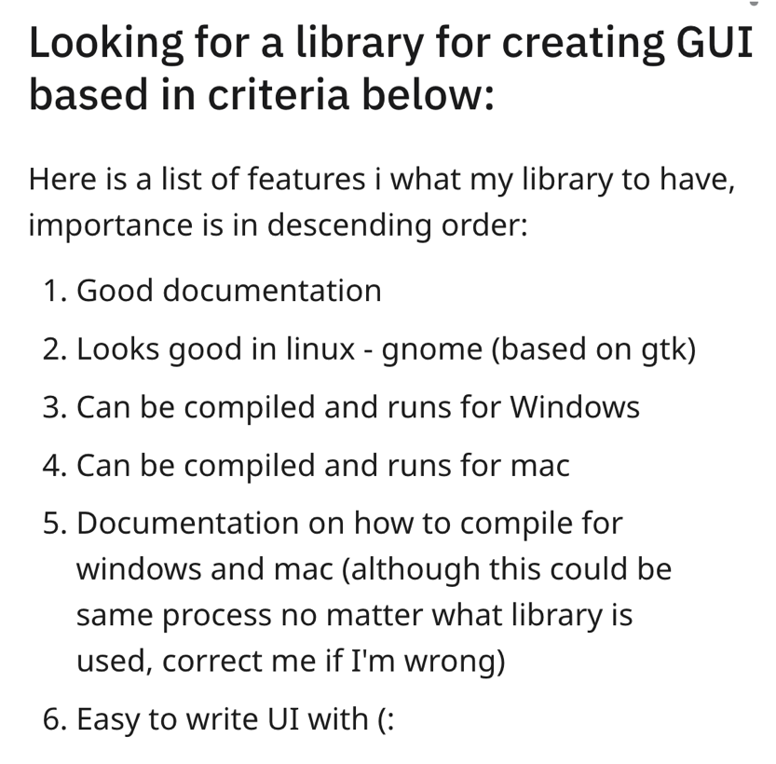
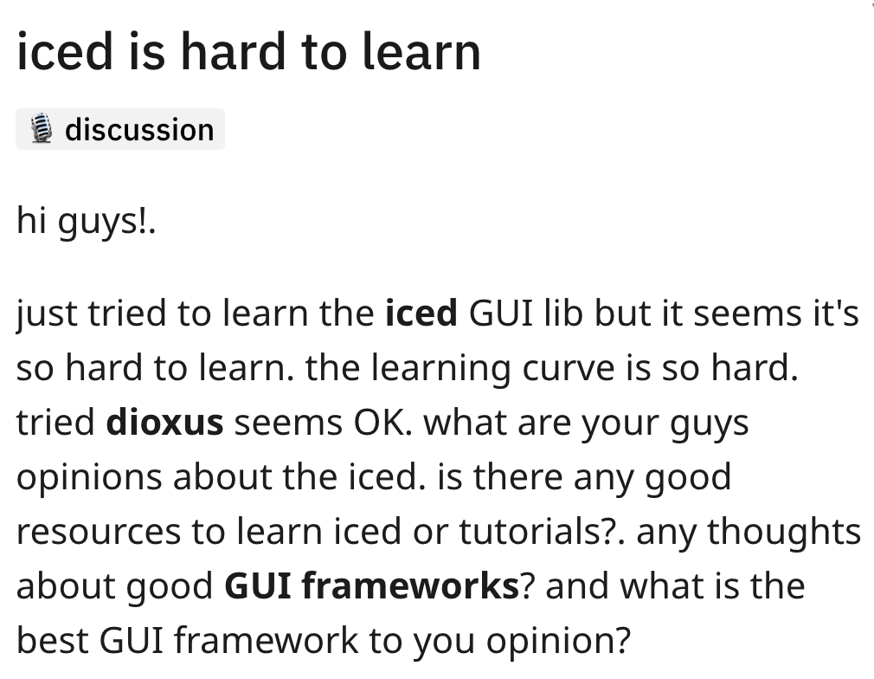

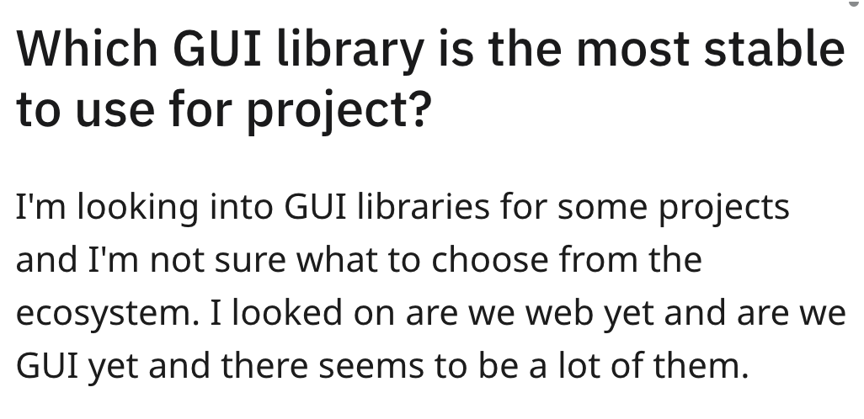
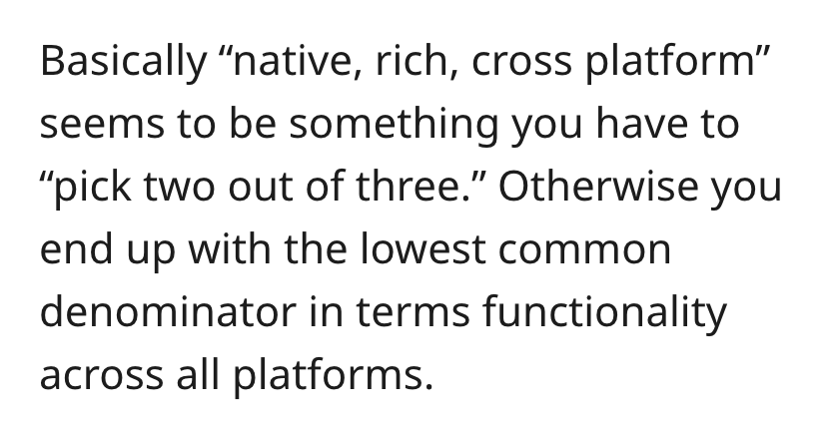
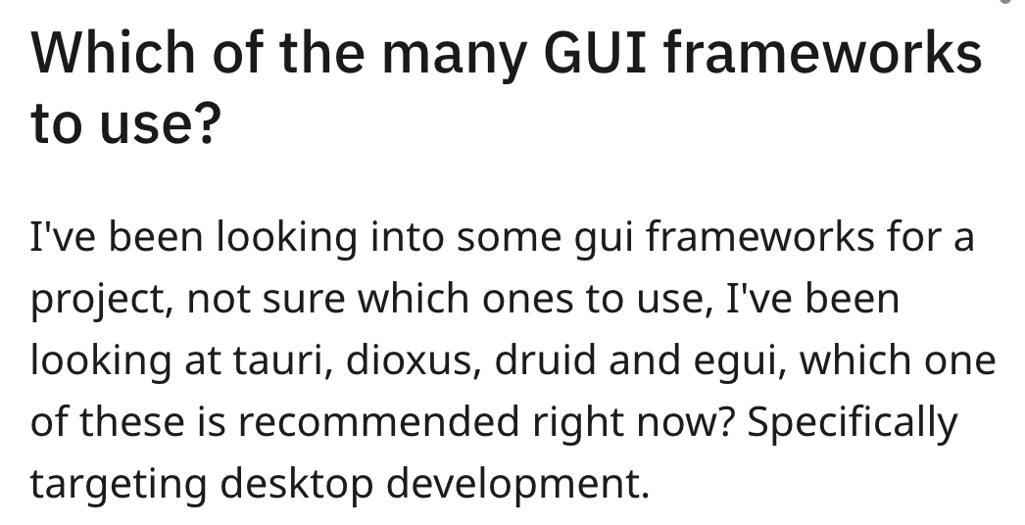
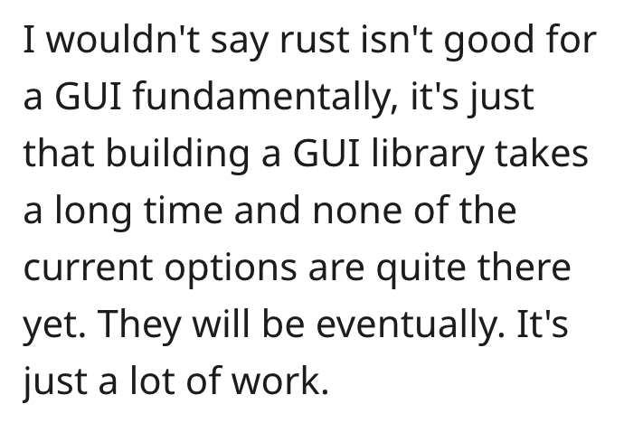
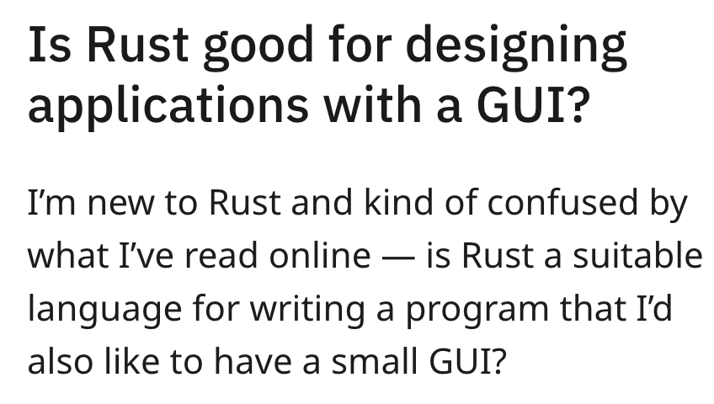
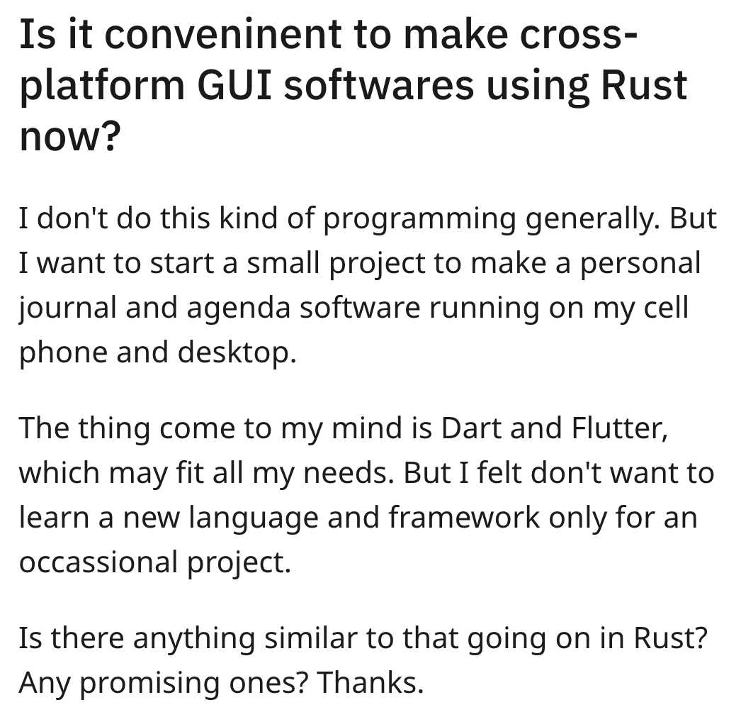
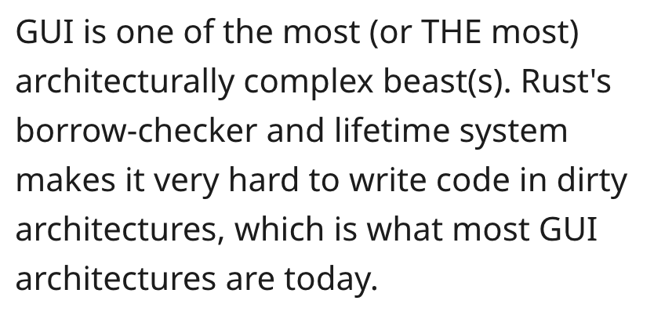
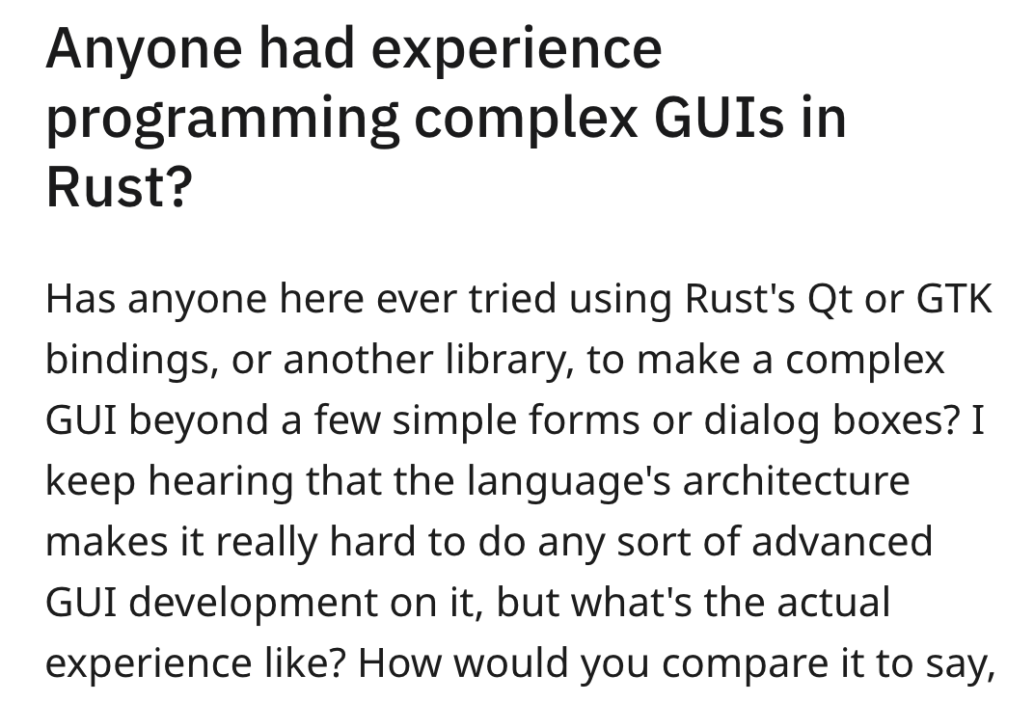
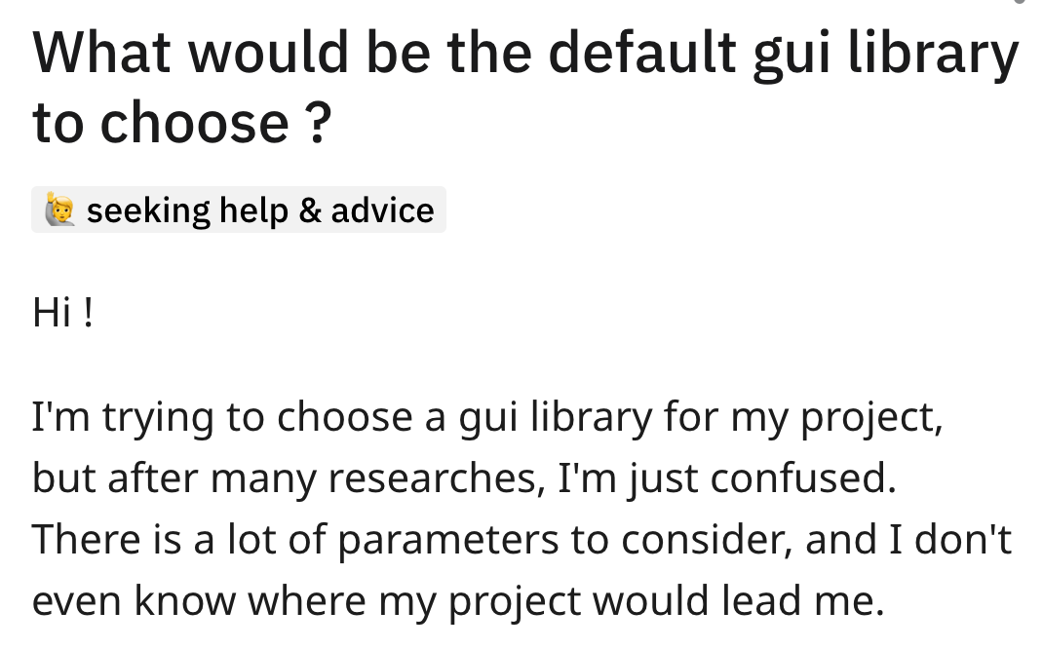
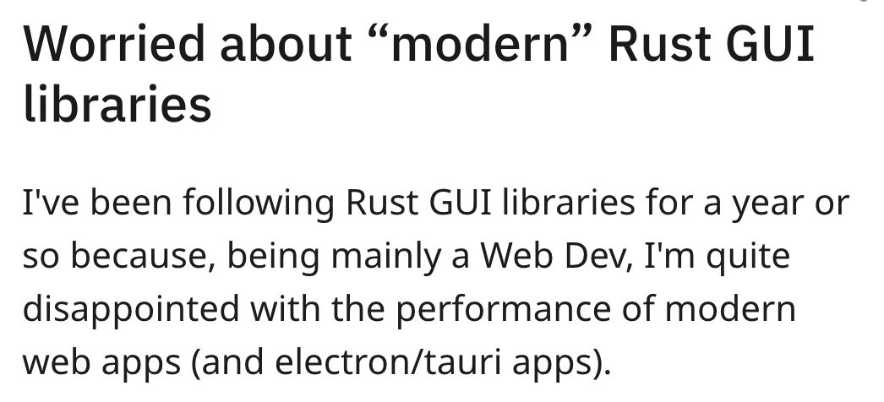
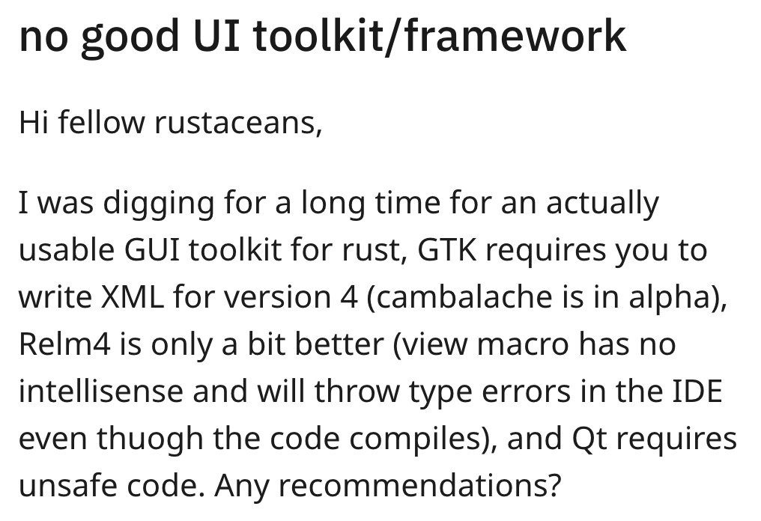
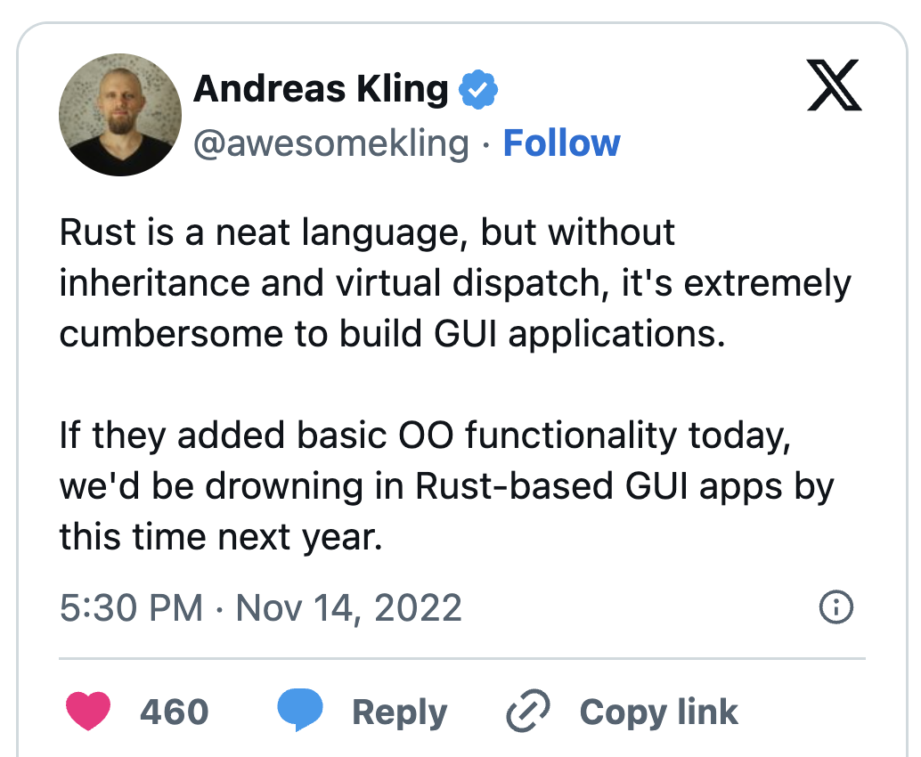
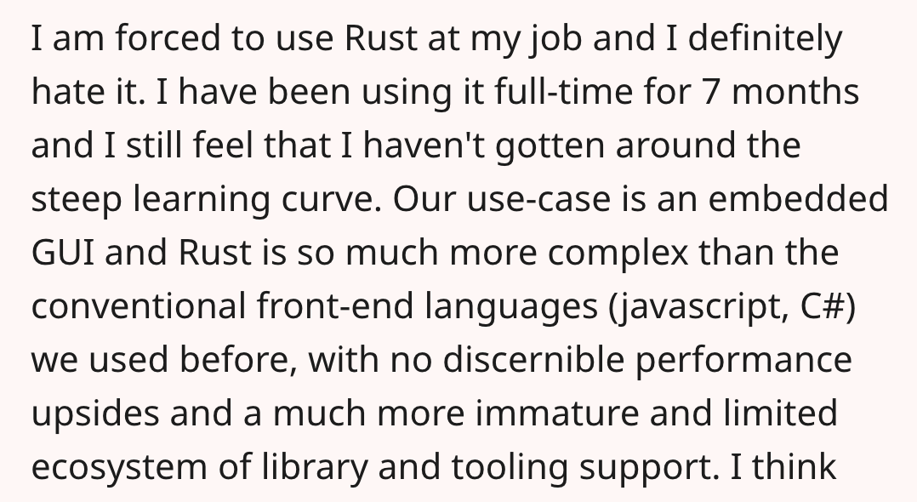
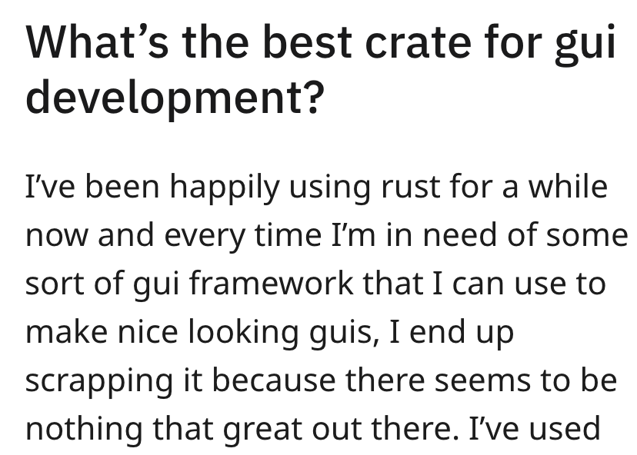
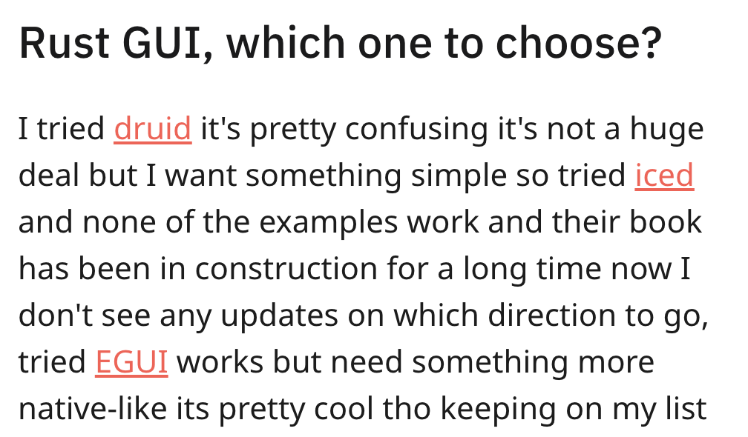
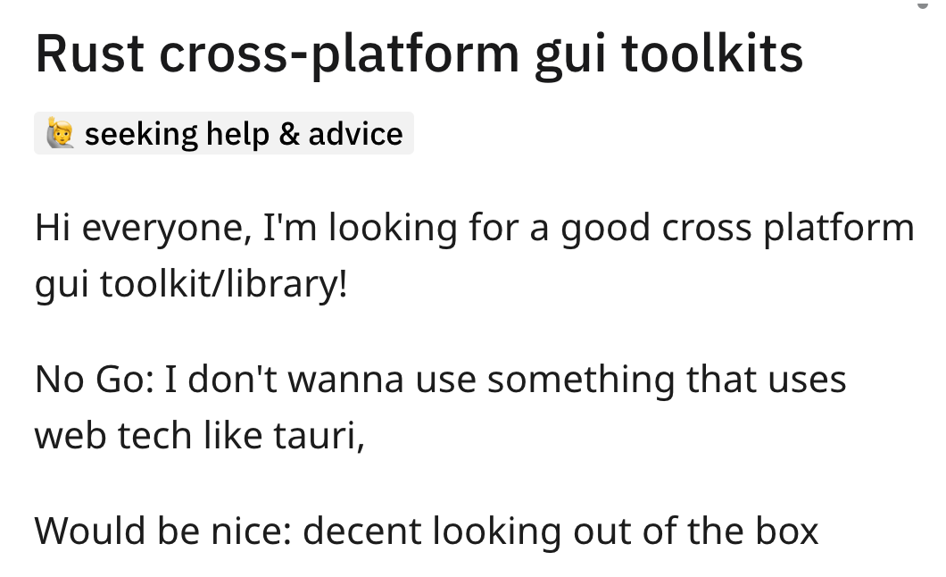
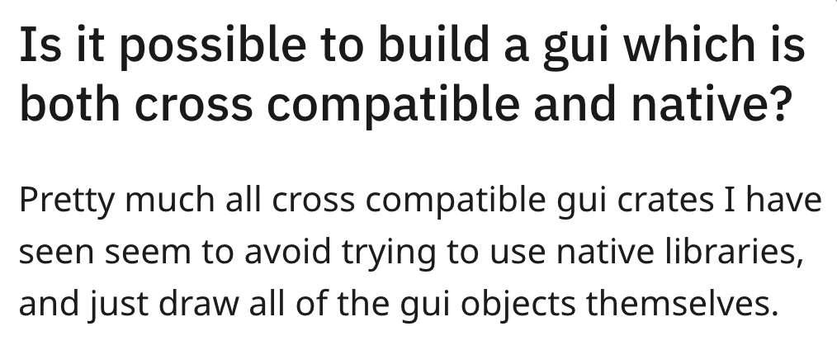

1. State of the Rust app dev ecosystem is rough
Notes:
If you don’t believe me, just search “Rust mobile app” or “UI in Rust” on any Rust forum or reddit page, and you’ll find hundreds, if not thousands of posts asking basically the same question

Slide 7
ok, ok, we get it

Slide 8

State of mainstream app dev in Rust
Apps developed using Rust have platform-related pain points
Typically use Rust for core business logic only
And/or use thin bindings/bridges to other native UI toolkits
Signal-iOS
Signal-Android
Signal-Desktop
Signal-Server
Swift UI
Java / Kotlin
TypeScript / JavaScript
Java EE
LibSignal (Rust)
iOS
Android
Desktop OS (Electron)
Server OS
Notes:
Another motivating factor for the Robius vision is that there is a strong business case to be made for application development in Rust.
The current set of existing major applications that are written in Rust all use Rust primarily for implementing an internal business logic layer.
As such, they have lots of fragmentation and unnecessary, expensive redundancy.
Signal maintains multiple application repositories, each with multiple languages that must interoperate with each other in complex manners,
with applications being developed separately on a per-platform basis.

Slide 9
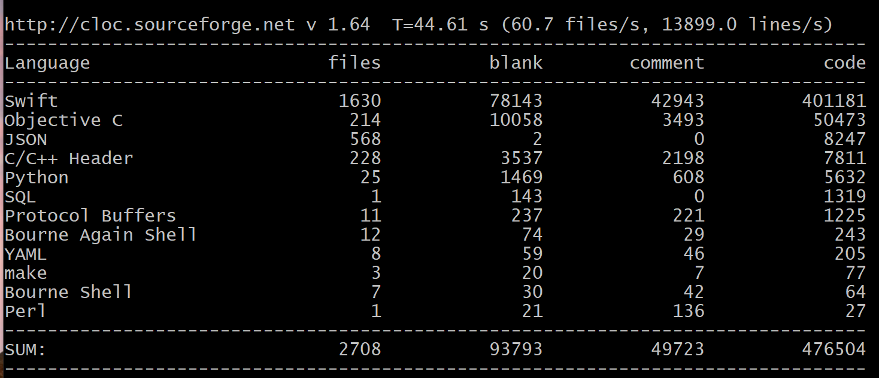
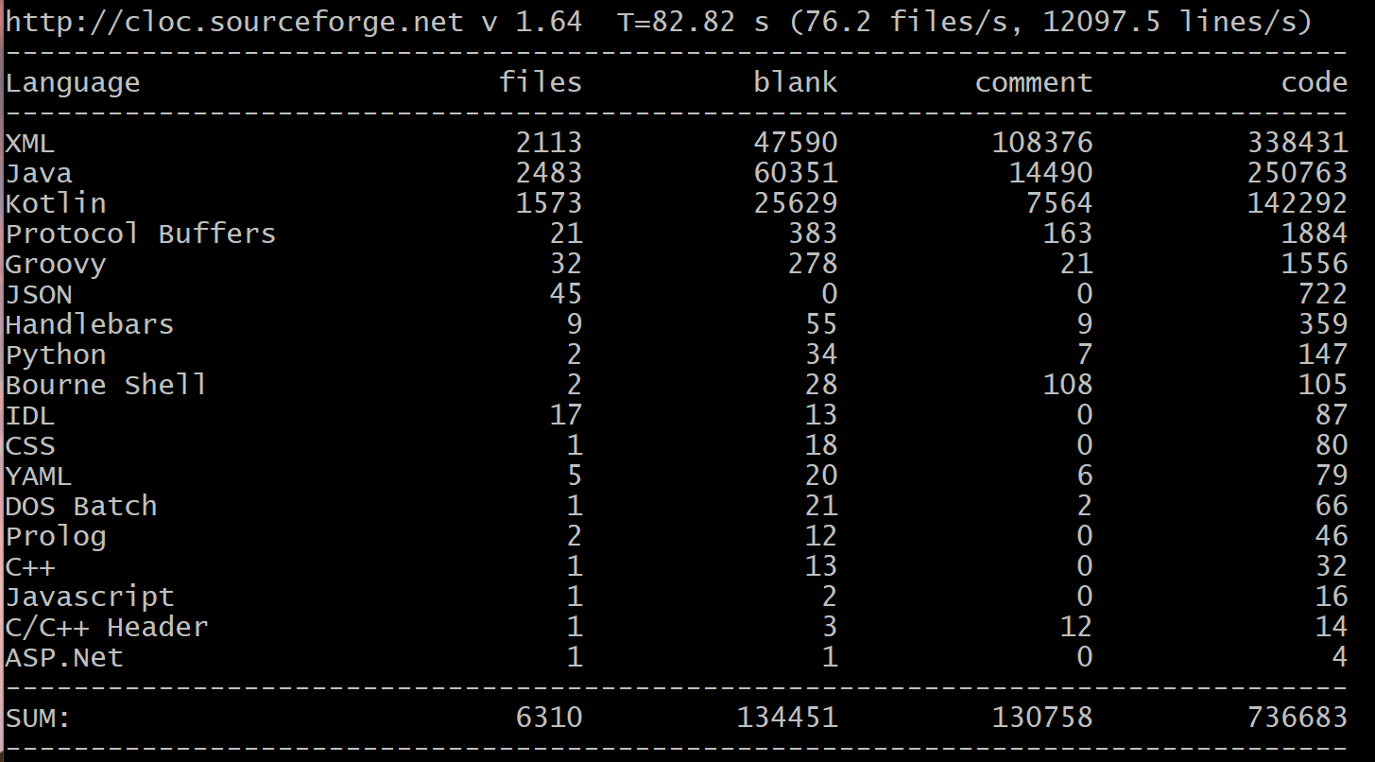
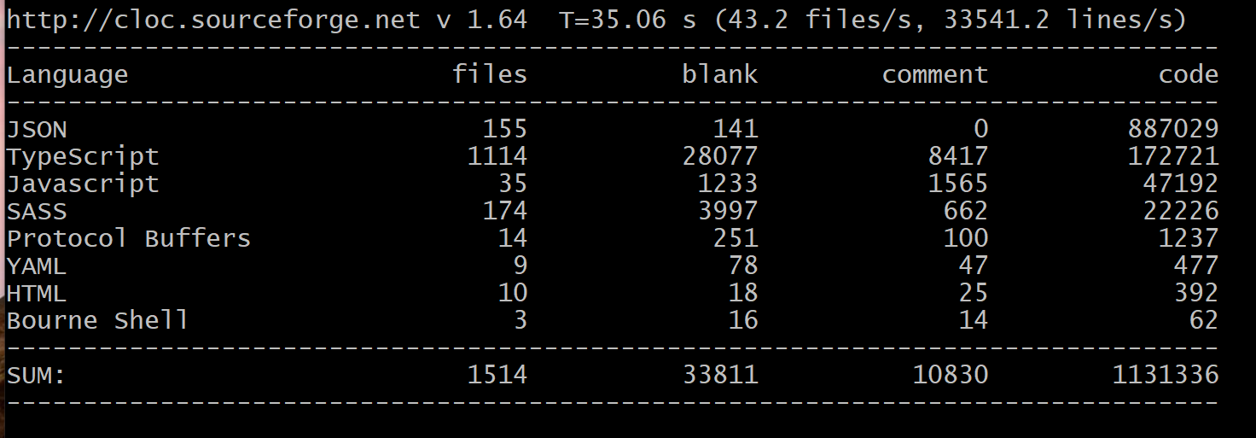
State of mainstream app dev in Rust
Signal maintains 3 separate app projects, with little overlap
350K LoC
450K LoC
iOS
Android
Desktop
250K LoC
Notes:
In Signal, these app repositories aren’t exactly tiny simple wrappers around a huge shared Rust library. It’s closer to the inverse of that.
As you can imagine, it is incredibly challenging to maintain consistency in both appearance and behavior.
To their credit, Signal has actually done an impressive job of just that, with help from the community, though naturally some things do slip through the cracks.
For example:
On Android – you can place secure Signal chats behind biometric lock, cannot search individual chat only
macOS – cannot screen lock Signal at all, text search UI button doesn’t work, no global search across all chats, no contact-specific notifications
iOS – no font size choice, different defaults, e.g., embedding link preview
Mobile platforms – different data usage settings (WiFi, roaming)

Slide 10
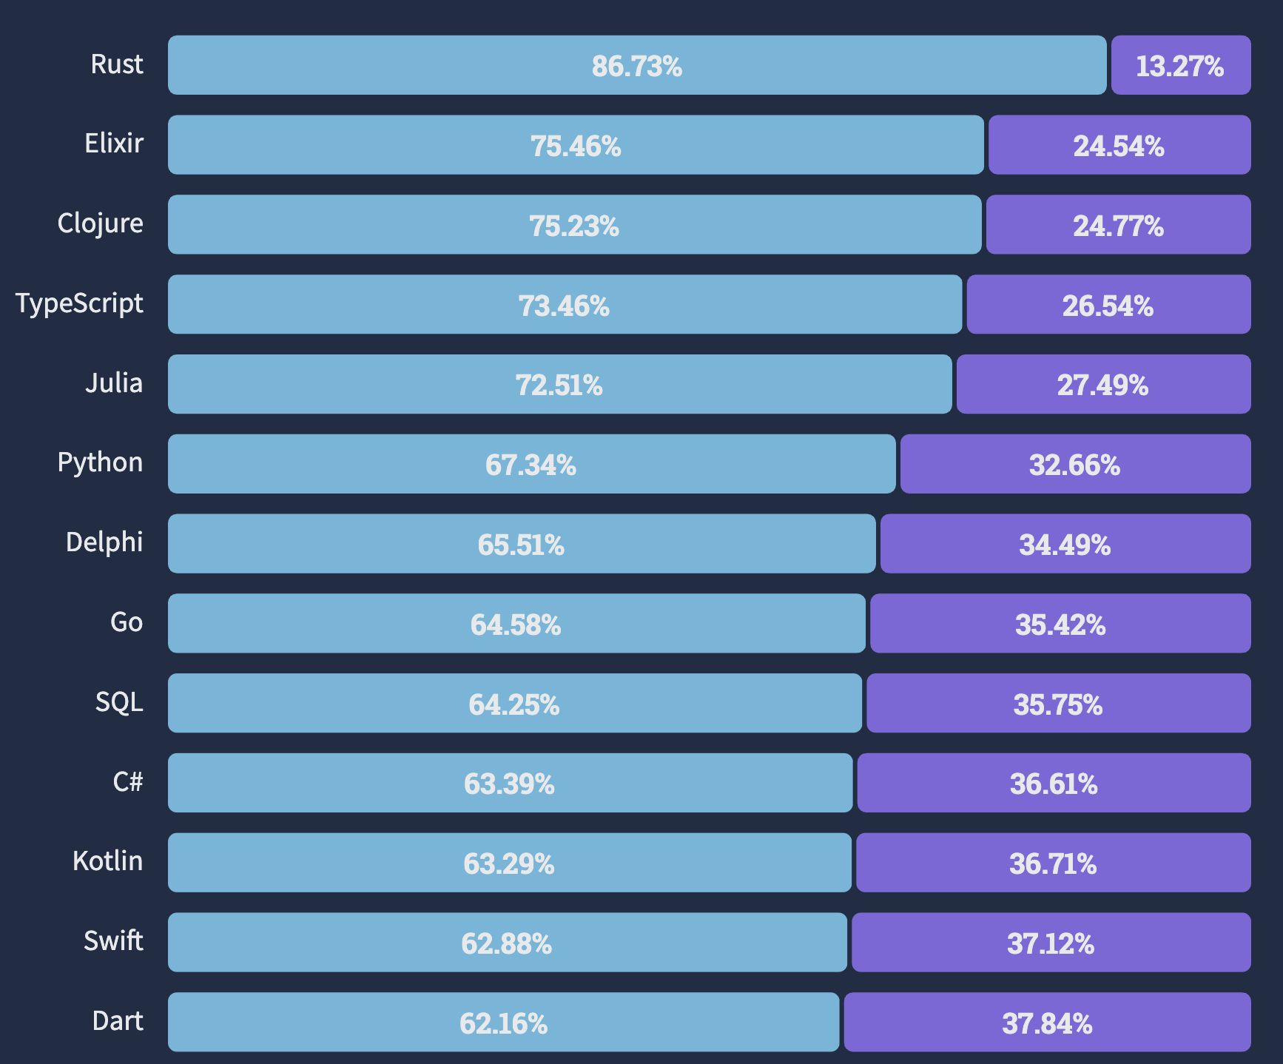
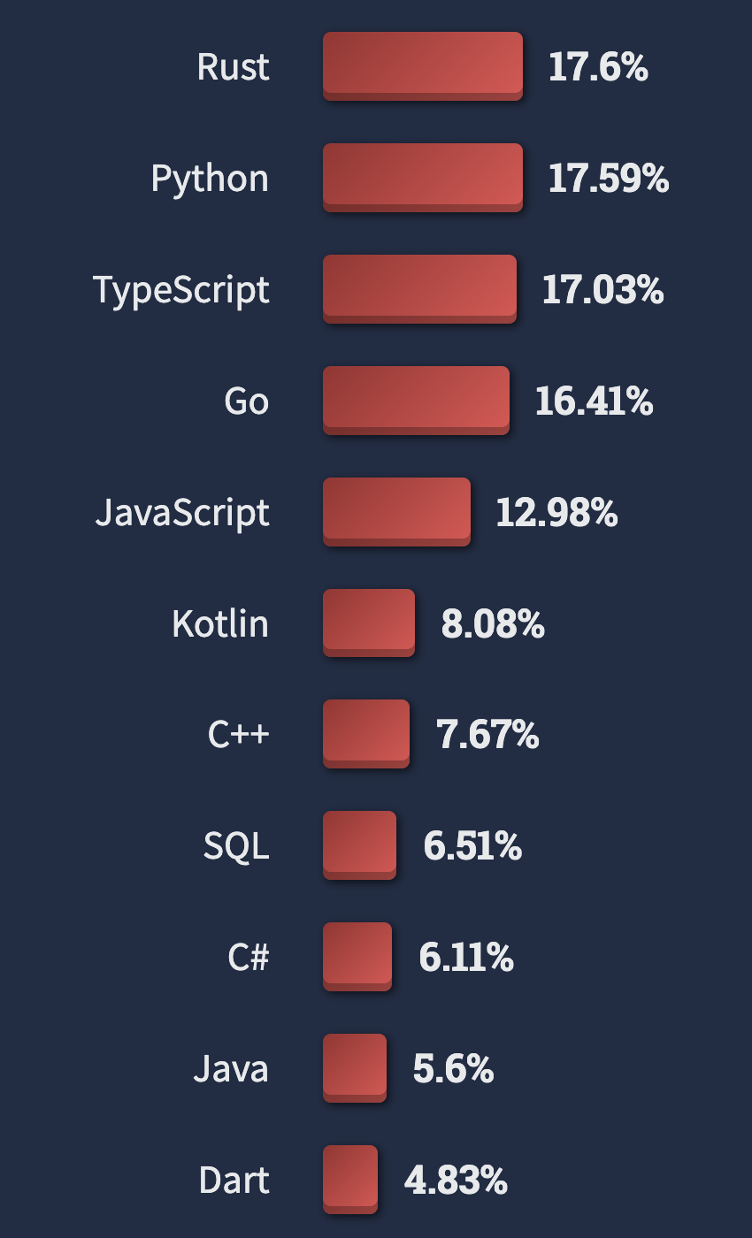
Why pure Rust? Rust itself is the right choice
Most loved language 8 years in a row … and most wanted
Let’s leverage its great featureset for multi-platform app dev:
Rust has already spread (almost) everywhere
Reaches many more domains than Dart
Easy, clear dependency management via cargo
Simple, built-in cross compilation with wide range of targets
Backwards compatibility across compiler versions
…
Notes:
Stack Overflow’s annual survey of 70,000 developers showed that, once again, Rust is the most loved language, this time for the 8th year running.
And for the first time ever, Rust was the most wanted language as well.

Slide 11






Rust itself is the right choice
Leverage Rust’s great features for multi-platform app dev:
Let’s leverage its great featureset for multi-platform app dev:
Rust has already spread (almost) everywhere
Reaches many more domains than Dart
Easy, clear dependency management via cargo
Simple, built-in cross compilation with wide range of targets
Backwards compatibility across compiler versions
Safety, runtime efficiency
Easy, clear dependency mgmt
Simple cross compilation
Ecosystem covers many domains
Notes:
Safety leads to increased correctness, eliminating memory & concurrency bugs
Higher reliability, less developer frustration and debugging difficulties
Amenable to formal verification and type-carried invariants
Less runtime overhead via static (compile-time) checking and guarantees
Focus on zero-cost abstractions (e.g., async state machines)
No garbage collection, static memory lifetime analysis
Monomorphization of generics
const eval, etc
Interactive systems, especially mobile, require good performance and efficiency; achievable with Rust
Performance is key for a smooth, responsive UI without jank
Efficiency is key for longer battery life, less heat output
Backwards compatibility across compiler versions, support for compiler editions
Good, clear dependency management via cargo
Built-in support for easy cross-platform compilation targeting, with a wide range of targets supported at various tier levels

Slide 12

Rust is great, but …
Some shortcomings from a UI standpoint
Lack of familiar OOP patterns; UI folks are accustomed to inheritance
Difficult to realize shared mutable state
Typical closure-based callback pattern → overuse of Rc<RefCell<…>>
Compilation is “slow”
But constantly improving … (see Nick Nethercote’s work)
Potentially steep learning curve for frontend devs
Mobile devs needed ~3.5 months of retraining to switch to Flutter
--
Source: https://verygood.ventures/whitepaper/business-value-of-flutter
Notes:
Rust has room for improvement in some areas, as it was originally envisioned for systems programming use cases and environments.
VGV survey about Flutter said mobile devs needed to be retrained to used Flutter, took a median 3.5 months
Rust could be even worse, as it is frequently said to have a high barrier to entry

Slide 13
Goals (selected)
Notes:
Project Robius has quite a few goals and technical requirements, which you can read about in full on our website or github page.
For now, in the interest of time, I’m going to just discuss a select few.

Slide 14


Reference design of full system stack
runtime components
Application
UI logic
UX logic
Application logic
Business logic
UI toolkit (Makepad, Dioxus)
Platform Abstractions
Networking
State mgmt
Storage
Multimedia
Widgets
Concurrency Manager
async executor, main & bkgd thread mgmt.
Power
Permissions
Connectivity
Sensors
Animation
Gestures
Input Events
Audio
Location
Notifications
Events
Drawing
IPC/Signals
Time/Alarm
Drag & Drop
Clipboard
FFI layer (Rust → native language)
Platform/OS Native Layers (Linux, macOS, Windows, Android, iOS, Web, HarmonyOS …)
details coming later…
Notes:
Our primary goal is to establish a complete, working example of everything beneath the app
Which must support major platforms/OS environments
UI toolkits – Makepad, Dioxus, Slint
Offers a variety of UI development options and styles
Generally cross-platform, with a focus on GUI design and workloads
OSIRIS - OS Interfaces in Rust
Rust abstractions of platform and OS-specific functionality
Focus on non-GUI subsystems
Standard subsystems: networking, storage, audio, time
UI-adjacent services: notifications, clipboard, drag & drop
Mobile-oriented:
Sensors/actuator: accelerometer/gyro, ambient light, pressure, temp, vibration, location, buttons, LEDs, biometrics
Multimedia: camera, mic, speaker
Touch screen, display brightness
Connectivity: WiFi discovery, bluetooth, NFC, USB, phone modem
Power: battery, charging, idle/standby/awake status
Permissions management: declaring, requesting, revoking
Goal: easy to integrate OSIRIS into a UI app as a dependency
Low-/zero-cost abstractions, as close to native as possible
Future: high-level, off-system mobile services
RESTful APIs: mapping, authentication, Google Play services, etc
Can likely use or start from the foundation of Open Mobile Hub
Concurrent / parallel computation runtime
Async execution runtime – ylong, tokio, async-std (smol)
Threads, thread pools, and CPU/multicore abstractions

Slide 15


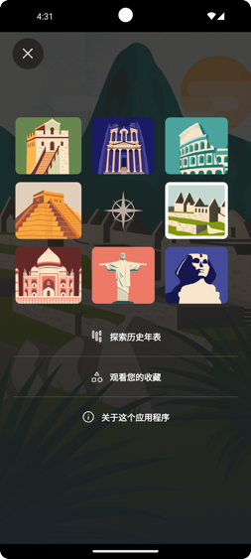







Proof-of-concepts demos + flagship apps
A series of ready-to-use simple example/demo apps
A few major commercial-grade flagship apps
Meta-goal: easy for new devs to fork & modify apps
Well-commented, well-structured code, plus docs
Notes:
A series of full-fledged, open-source example apps
These are smaller apps that demonstrate specific features, with mock app logic and stubbed-out incomplete business logic
Basic shopping estore app, e.g., amazon, taobao, ebay
News feed / social media, e.g., twitter, facebook
Social Video sharing apps, e.g., tiktok
Notes app, simple text editor, e.g., google keep
Basic drawing app, e.g., paint
Easy for new devs to fork & modify, well-commented with accompanying docs
One flagship app, at least initially, which I’ll discuss on the next slide
: a complete Matrix chat client (FluffyChat clone), similar to Signal
Fully-complete UI, UX, application, and business logic
Multiple separate UI pages with storyboard flows
Authentication, send/recv/sync messages
A/V chat (multimedia I/O): camera, video playback, mic, audio out
Persistent state (config/settings), local data storage, user profiles
Many small (micro)benchmark apps for testing (and CI) of underlying stack
Sensors: simple display of raw input sensor data, plus basic sensor fusion
Screen brightness adjustment slider, plus automatic brightness based on ambient light sensor
Input event dumper – touch, click, hover, drag, scroll, pinch zoom gestures
etc

Slide 16
Select technical goals
build-time, dev tools
runtime behavior
Quick compilation
Efficient, performant execution
Platform policy compliance
Consistent abstractions
Fast app startup
Flexibility for third-party components
Notes:
[runtime] Efficient execution → native performance
[runtime] Fast application startup
Keep binaries small, allow loading libraries at runtime
[dev] Quick compilation times
At least for incremental compilation
Good news: modern app dev UI kits focus on live coding
[dev] Consistency across platforms
But easy to descend beneath abstractions to call platform-specific code
[both] Compliance with platform policy restrictions
Generated app packages must be publishable to platform app stores
e.g., iOS forbids JIT compilation, dynamically loading new code
Could potentially circumvent this by downloading/running WASM code (is this legal on iOS/Android?)
[mostly dev] Flexibility to incorporate third-party components
At a bare minimum, OSIRIS components, standard Rust crates
Fast application startup
Quick compilation times
At least for incremental compilation
Good news: modern app dev UI kits focus on live coding
Consistent abstractions across platforms
But easy to descend beneath abstractions to call platform-specific code
Flexibility to incorporate arbitrary third-party components
At a bare minimum, OSIRIS components
Efficient execution (low runtime overhead) → native performance or better
Compliance with platform policy restrictions
Generated app packages must be publishable to platform app stores
e.g., iOS forbids JIT compilation, dynamically loading new code
Could potentially circumvent this by downloading/running WASM code (is this legal on iOS/Android?)

Slide 17

Quick compilation
Modern Rust UI kits combat this with live reloading of DSL elements
Structure of many small crates
Benefit: parallel compilation units
Minimize dependencies ruthlessly
Fast incremental compilation (at the very least)
“rustc is slow” — everyone
Notes:
Rust compilation time has long been a contentious issue
Significant work from the compilers team to speed up rustc
Honestly not nearly as bad as the internet hivemind seems to think.
Robius: strive for structure of many small crates
Benefit from largely parallelizable compilation units
Modern Rust UI kits combat this with live reloading of DSL elements
Makepad goes further to minimize dependencies for fast compilation
Custom-tailored subset of platform framework dependencies
Fast incremental compilation (at the very least)

Slide 18

Consistency across multiple platforms
Key principle:
Devs shouldn’t be required to touch platform-specific code
But should be able to, if desired, with relative ease
Secondary principle:
Platform-agnostic code imposes no overhead
As close to underlying native platform as possible

Slide 19
Major Challenges

Slide 20
Significant systems challenges
Exposing & abstracting platform APIs / OS services
Handling complex multi-step builds
Rust compilation: invoking & configuring Cargo
Standardizing compilation of non-Rust system glue layers
Supporting platform-specific toolchains and linking conventions
Defining and executing pre- and post-compilation steps
Signing, bundling/packaging, distributing apps
Required for displaying notifications (and so much more)
Managing concurrency: multi-threading, async/sync, hetero CPUs…
UI & other select workloads must run on “main” thread
Certain APIs require async, others forbid async
Contending with multiple vastly different UI toolkits
Platform support crates must be easy to integrate with UI system internals
all across
disparate
platforms
Notes:
Permissions handling
Collecting and merging permissions from app, UI toolkit, dependencies

Slide 21
for more info, see our upcoming joint whitepaper:
The state of Rust GUI systems
(being organized by Nico Burns)

Slide 22
Project Architecture

Slide 23
Project Robius: a diverse community
Key community projects:
Robius:
overall integration & app dev
platform feature abstraction crates
OSIRIS:
signing, bundling/packaging, distribution (wrapping cargo)
OS service wrappers/FFI crates
Quake-build:
meta-build tool (à la make)
orchestrate pre- & post-compile steps
Others (me)
concurrency management
generic caching of widgets (populating & drawing UI data)
Targeted UI toolkits:
Makepad
Close daily collaboration
Robius makes UI & system contributions back to Makepad
Dioxus
Goal: fill gaps in dioxus-std
Acts as diverse point in space of integration implementation
Linebender project (Xilem, etc)
Periodic exchange of ideas
Co-leverage Android knowledge
Tauri
Utilize existing desktop crates
Offer mobile crates back (like Dioxus)
Notes:
Project domains that are part of the Robius community
UI toolkits (e.g., Makepad)
Build tooling — OSIRIS and Quake-build
Signing, bundling, packaging, distribution
Build orchestration
Platform feature crates and Rust abstractions — Robius, OSIRIS
Integration layers between UI toolkit and platform abstractions
Reduce burden on app dev (approaching zero)
Additional challenges we’re tackling
Concurrency management (dealing with req’d async functions, functions that can only run on main thread, auto-offload to background threads, multithreading thread pools, etc
Generic Caching of UI drawing work
Massive improvement in paths with heavyweight UI population computations
Integrate with OS’s low-memory warning
There’s a one-to-one correspondence among the previous challenges and each of the community projects here.
For example, I on the Robius project tackle things like Rust abstractions for platform-specific features, which I’ll show in more detail in a few slides.
The OSIRIS project handles things like packaging application binaries, assets, resources, etc into a single bundle, signing that bundle, and distributing it using each platform’s native package manager. OSIRIS and Robius together handle supporting OS services and FFI layers between Rust and the underlying platform.
The Quake project is a meta-build tool (kind of like Make but way better) that handles top-level build commands, like configuration, invoking cargo and other platform-specific build tools in a flexible manner. It’s built on nushell, a pure-Rust shell implementation, that has its own type-safe syntax for specifying build target rules and configuration key-value pairs.
The concurrency, threading, and async concerns will be handled by Robius, in cooperation with the UI toolkit.
Robius is interested in supporting multiple UI toolkits, but our primary target is Makepad, a multi-platform UI framework written from scratch in pure Rust to support native widget drawing and basic input events. Unlike most other UI toolkits, it does *NOT* rely on an underlying web engine, as with Dioxus and Tauri, nor does it rely on the winit window management project, as is being explored by the Linebender project.

Slide 24
Application
UI logic
UX logic
Application logic
Business logic
Guiding philosophy: stay out of UI’s way
Let UI experts do what they do best
UI toolkit + app logic act as active driver
Robius, OSIRIS, etc are supplementary
Independent from UI
Offer easy integration w/ supported UI toolkits
Passive libraries driven by app
UI toolkit (Makepad, Dioxus)
Platform Abstractions
Networking
State mgmt
Storage
Multimedia
Widgets
Concurrency Manager
async executor, main & bkgd thread mgmt
Power
Permissions
Connectivity
Sensors
Animation
Gestures
Input Events
Audio
Location
Notifications
Events
Drawing
IPC/Signals
Time/Alarm
Drag & Drop
Clipboard
FFI layer (Rust → native language)
Platform/OS Native Layers (Linux, macOS, Windows, Android, iOS, Web, HarmonyOS …)
Notes:
UI toolkits – Makepad, Dioxus, Slint
Offers a variety of UI development options and styles
Generally cross-platform, with a focus on GUI design and workloads
OSIRIS - OS Interfaces in Rust
Rust abstractions of platform and OS-specific functionality
Focus on non-GUI subsystems
Standard subsystems: networking, storage, audio, time
UI-adjacent services: notifications, clipboard, drag & drop
Mobile-oriented:
Sensors/actuator: accelerometer/gyro, ambient light, pressure, temp, vibration, location, buttons, LEDs, biometrics
Multimedia: camera, mic, speaker
Touch screen, display brightness
Connectivity: WiFi discovery, bluetooth, NFC, USB, phone modem
Power: battery, charging, idle/standby/awake status
Permissions management: declaring, requesting, revoking
Goal: easy to integrate OSIRIS into a UI app as a dependency
Low-/zero-cost abstractions, as close to native as possible
Future: high-level, off-system mobile services
RESTful APIs: mapping, authentication, Google Play services, etc
Can likely use or start from the foundation of Open Mobile Hub
Concurrent / parallel computation runtime
Async execution runtime – ylong, tokio, async-std (smol)
Threads, thread pools, and CPU/multicore abstractions
https://www.openmobilehub.com/getting-started/

Slide 25
Application
Application
UI / UX
Convos/ rooms list
Chat view
Room browser
Application logic
Business logic
Persistent settings
Push notifs.
Local msg database
Online status
File sync
Join/ leave room
Matrix message send/recv
read status
Settings, Themes
In-app notifs.
Context for chat/msg
Robrix App Architecture
(Matrix Chat Client)
Robrix’s needs determine feature development and implementation priority
Image viewer
Create or delete chat
Quick replies
Access camera, mic, speaker
Multi-device login mgmt
Account management
Contacts
Video display
File/media chooser
Search
Rich text fmt
Multimedia streaming, calling
Reactions
Local media storage
Authentication
Thread view
Reply linking
UI toolkit (Makepad, Dioxus)
Platform Abstractions atop OSIRIS
Concurrency Manager
Concurrent Runtime
async executor, multithreading, thread pools
Networking
State mgmt
Storage/Cache
Multimedia
Widgets
async executor
CPU affinity
Input Events
Audio
Connectivity
Notifications
Animation
Gestures
Authentication
Permissions
Drag & Drop
Clipboard
Events
Render
main/bkgd threading
FFI layer (Rust → native language)
Platform/OS Native Layers
Notes:
We’re leading the development of this app to help drive the design of OSIRIS and prioritize which service abstractions we implement first.
We expect this application to consist of quite a few entities spread across the application, both for app logic and business logic,
as well as significant UI and UX components that will serve as valuable stress tests for the UI toolkits, which are still in active development.
One good thing about this choice of application category is that there are several existing examples,
which we can use as a basis of comparison to help evaluate key aspects of Robius like overall performance, ease of development, and more.
Those applications include:
Element, the first-party Matrix chat, and their newer apps Element-X that I previously mentioned,
Fluffychat, a Matrix chat client written in Flutter,
Quadrix
Cinny
Schildi Chat

Slide 26
Targeted platform abstractions / OS service APIs
System notifications
Biometrics & authentication
File/image picker dialogs
Context menus (OS-native)
Menu bar (desktop only)
Rich clipboard
Drag & Drop
Default URI/Intent handling
Content sharing to foreign app
Native font access
Input Method Editors (IME)
Native gesture recognition
Connectivity management
WiFi, Bluetooth, NFC, nearby devices
GPS/Location access
Multimedia capture
Device discovery & configuration
Camera – snapshots, video, settings
Audio – input, MIDI, playback
Sensors
Native alarms, timers
Keychain (secret storage)
Power management/status
App lifecycle state transitions
and so much more …

Slide 27
Status — just getting started, lots to do!
System notifications
Biometrics & authentication
File/image picker dialogs
Context menus (OS-native)
Menu bar (desktop only)
Rich clipboard
Drag & Drop
Default URI/Intent handling
Content sharing to foreign app
Native font access
Input Method Editors (IME)
Native gesture recognition
Connectivity management
WiFi, Bluetooth, NFC, nearby devices
GPS/Location access
Multimedia capture
Device discovery & configuration
Camera – snapshots, video, settings
Audio – input, MIDI, playback
Sensors
Native alarms, timers
Keychain (secret storage)
Power management/status
App lifecycle state transitions
and so much more …
Notes:
Most of these, but not all, are useful within Robrix but not technically mandatory.
Approximate proposed order:
Biometrics/authentication
Open URI / share object to another app (Intents, “sharesheet”)
Geolocation
System notifications
Native file/image picker dialog
Native font access (fallback for UI-packaged font stack)
Registration as default app (Intent handler)
Native rich clipboard access with full-MIME types
Native context menus

Slide 28
Simple philosophy:
Native-first, or as close to it as possible
Little to no (avoidable) dependencies
Notes:
Our guiding philosophy when implementing platform feature crates is:
Keep it simple, with no fluff or overly complex abstractions. We don’t want to impose unavoidable overhead just to let you access something from Rust code.
Minimize dependencies, keep compile times low and the sizes of code and binaries down.
For ex, early on in our journey we were using tokio’s one-shot channels for callbacks in some of the platform crates
But then we realized just how heavyweight certain deps like that can be (same for things like serde), so we only now use such deps if they’re unavoidable.
And in the case where we actually do need them, we can offer a minimal pared-down version of that crate that can be used by the framework by default
Then, if an application does need the full crate, it can replace it with a Cargo-level patch statement

Slide 29
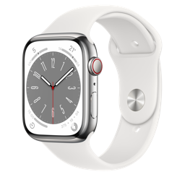








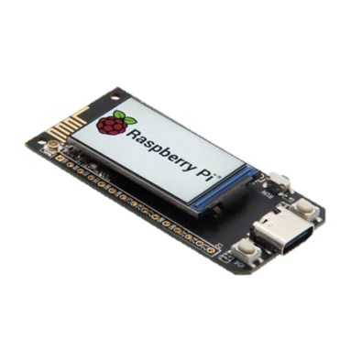
Platforms of interest
Desktop
macOS
Linux (primarily Debian-based)
Windows
Mobile
Android
iOS
[Future] OpenHarmony OS
Web, wasm
Others?
Select microcontrollers/peripherals
tvOS, watchOS

Slide 30
Demo time!

Slide 31
Demos across multiple platforms
Flagship apps
Robrix – Matrix chat client
Moxin – run LLMs locally (à la LM studio)
Simple apps
robius-demo-simple
Shows platform features: authentication, opening URIs
Wonderous copycat app
Libraries & Infrastructure (Examples from Android)
android-build
Build Java source for Android from a Cargo build script
robius-android-env
Abstraction for hassle-free access to UI toolkit-owned Android state

Slide 32
<demo>

Slide 33
Demo overview for future offline viewers
Demo examples of robius-android-env
Plus a before & after of robius-authentication/robius-open using it
And also robius-demo-simple using it (previously had platform-specific code for android only, now have nothing)
Mention how we strive to remove the burden of implementing glue code from both the app developer and the UI toolkit maintainer
It should “just work”

Slide 34
Demo overview for future offline viewers
Demo of how to use android-build, similar to `cc-rs`
Plus a before & after of using it in robius-authentication’s build.rs script (showing how much simpler it is)
Mention that lots of work went into it to ensure it works on all host OS platforms (Linux, macOS, Windows)
Convenience features like auto-detection of the Java home directory and your Android SDK installation
Establishes standardized env vars for overriding/customizing build behavior
Future: support defining more parameters via cargo metadata

Slide 35
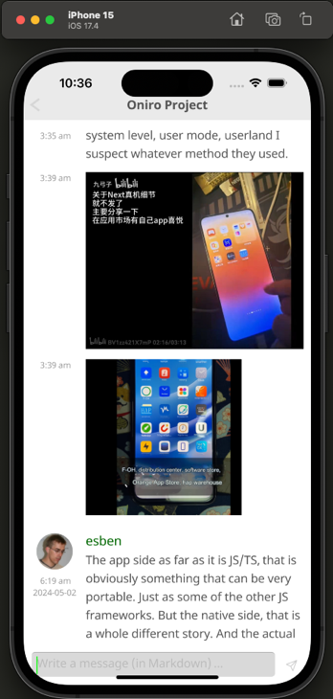
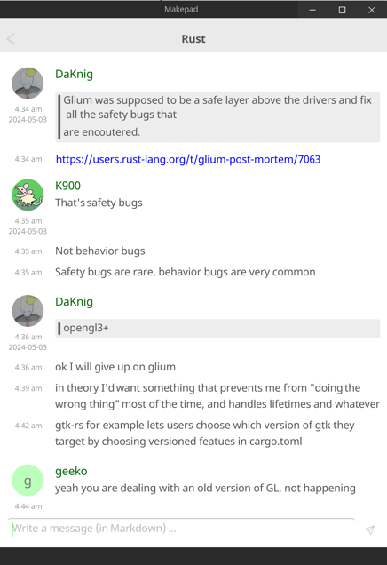
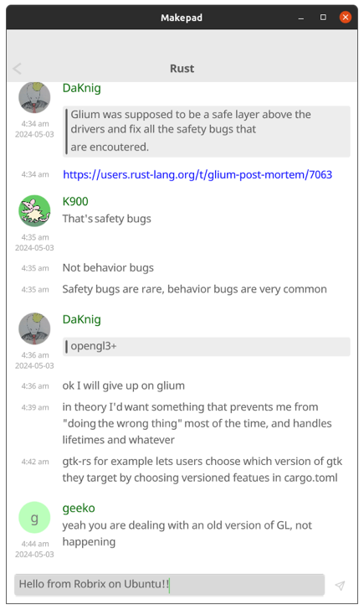
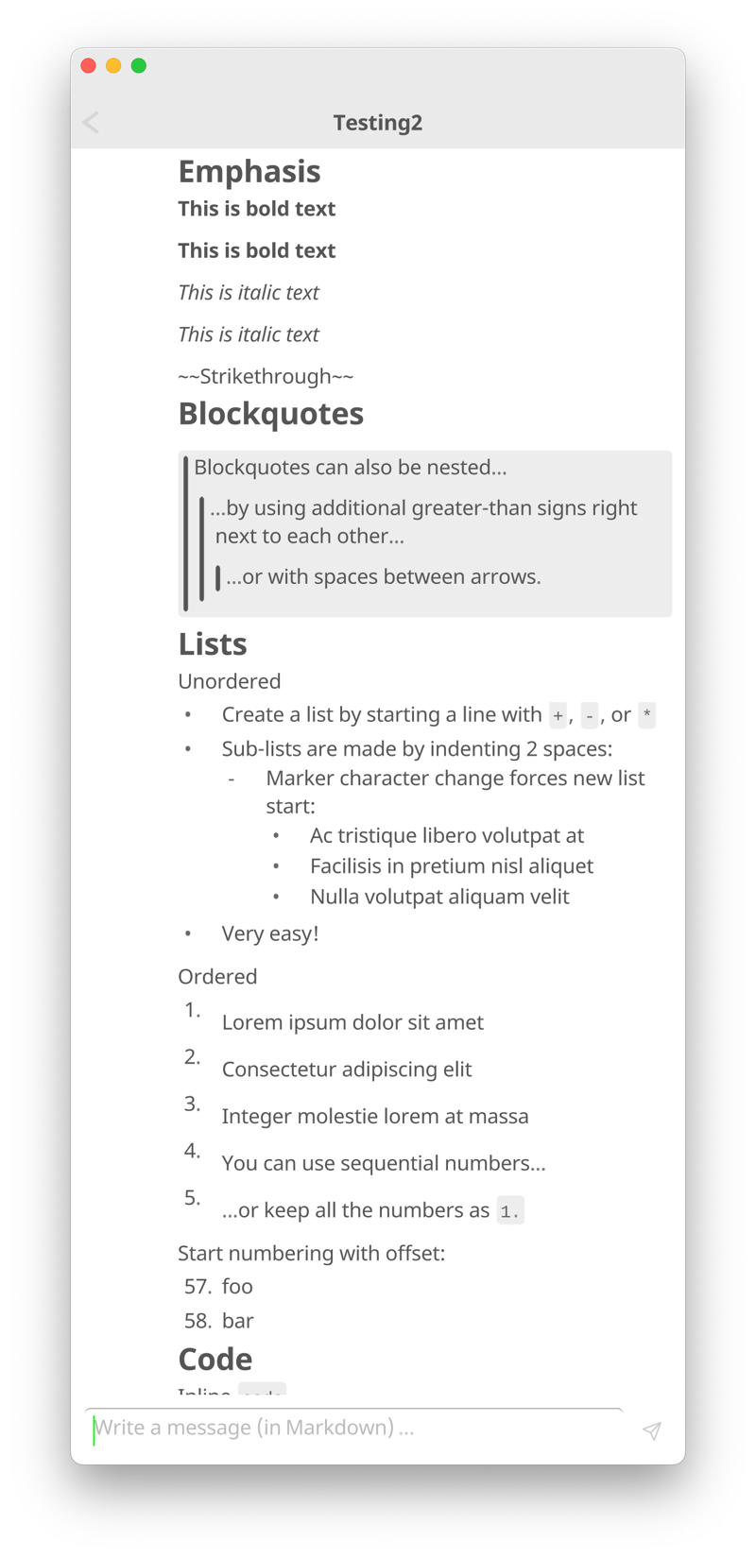

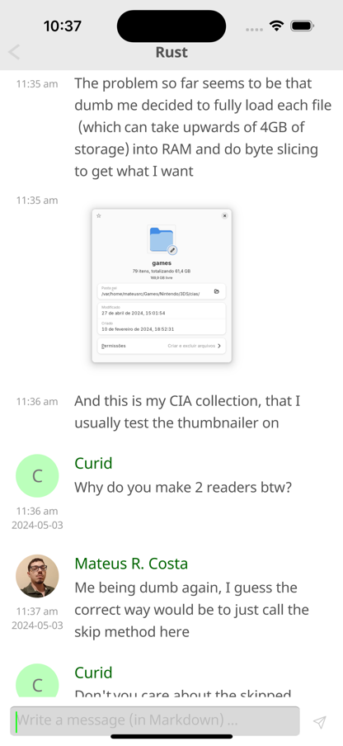
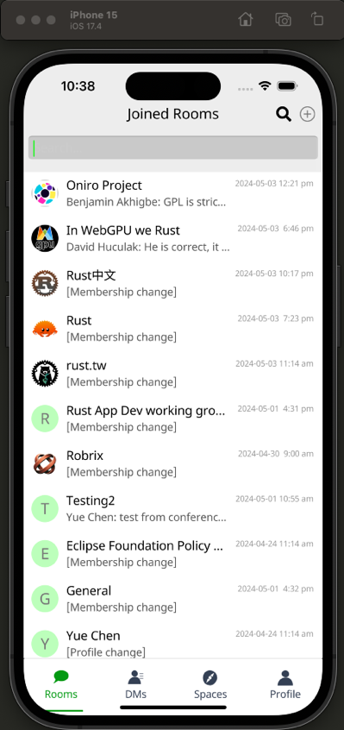
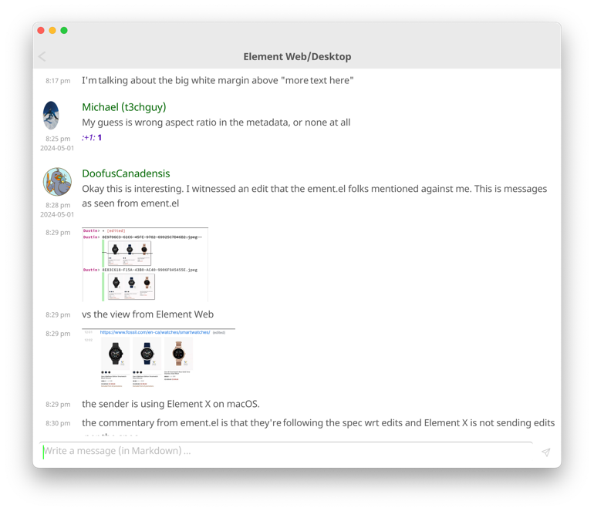
Robrix
One code base, many platforms

Slide 36
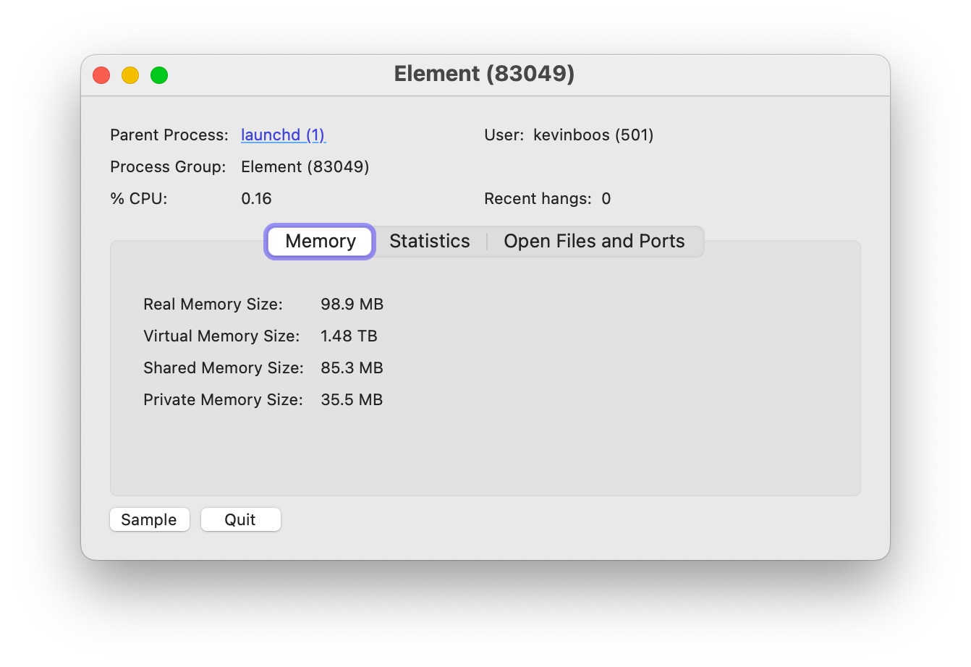



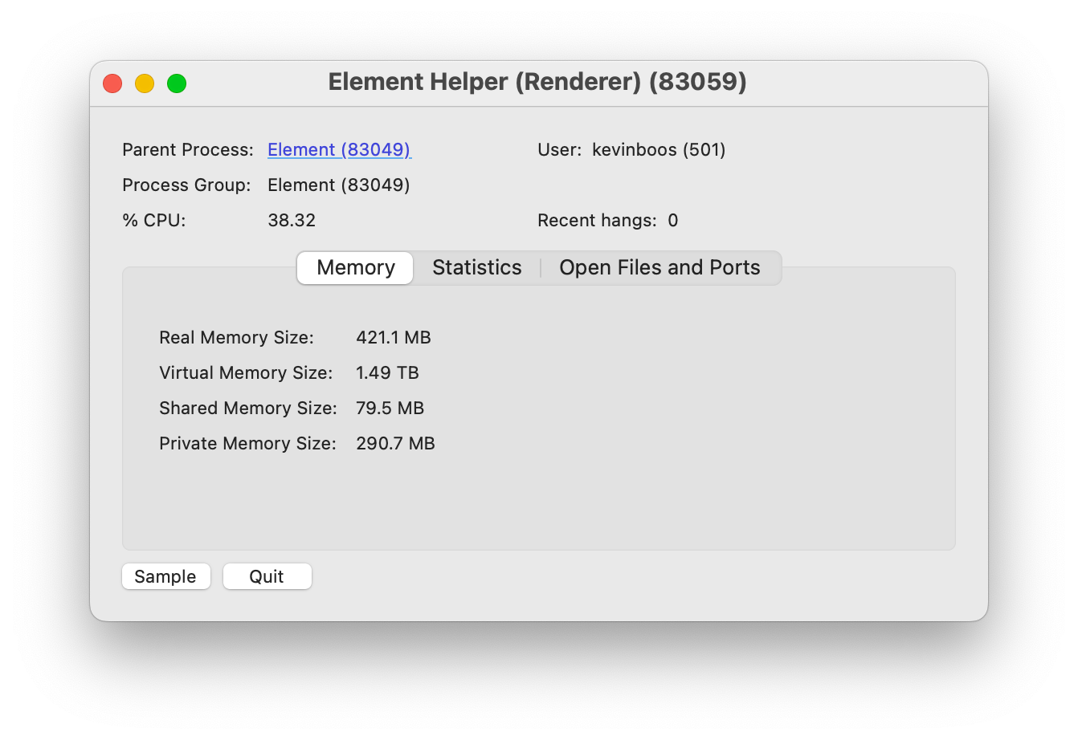
Makepad + Robius stack is efficient
30% fonts
32% framebuffers
→ Related benchmarks for Makepad:
robius.rs/blog/performance-benchmarking-2/
Notes:
Plus a sub-10 sec compile time from a clean build

Slide 37
Robrix development revealed a concurrency challenge
impl Widget for TimelineView {
fn draw_walk(&mut self, cx: &mut Cx2d, scope: &mut Scope, walk: Walk) -> DrawStep {
while let Some(item_id) = self.list.next_visible_item(cx) {
let Some(timeline_item) = self.tl_items.get(tl_idx) else { ... }; if let TimelineItemKind::Event(event_tl_item) = match timeline_item.kind() {
if let TimelineItemContent::Message(message) = event_tl_item.content() {
if let MessageType::Image(image) = message.msgtype() {
let (item, existed) = list.item (cx, item_id, live_id!(ImageMessage))?;
let Some(mimetype, width, height) = image.info.as_ref() else { return }; let text_or_image_widget = item.text_or_image(id!(content.message));
let media_request = MediaRequest { source: image.source, format: ... };
let data = matrix_client.media().get_media_content(&media_request, true).await?;
text_or_image_widget.show_image(|img| utils::load_png_or_jpg(&img, cx, &data));
...
}
}
}
}
}
}
A typical first attempt to fetch and draw an image
error[E0728]: `await` is only allowed inside `async` functions and blocks
|
1048 | fn draw_walk(
| ------------- this is not `async`
...
1132 | let data = matrix_client.media().get_media_content(&media_request, true).await?;
only allowed inside `async` functions and blocks ^^^^^
Notes:
Insert slide of some simplified code that shows two problems when failing to properly deal with mixed (forms of) concurrency
Invoking a blocking function from the main UI thread will hang the UI
Even if the function is async, it could still be blocked while the async executor is running during its timeslice
Key point: don’t try to run async functions (spawn async tasks) on the main UI thread
Trying to invoke an async function directly from the main thread
Also happens if you did it from a regular background thread

Slide 38
Robrix development revealed a concurrency challenge
impl Widget for TimelineView {
fn draw_walk(&mut self, cx: &mut Cx2d, scope: &mut Scope, walk: Walk) -> DrawStep {
while let Some(item_id) = self.list.next_visible_item(cx) {
let Some(timeline_item) = self.tl_items.get(tl_idx) else { ... }; if let TimelineItemKind::Event(event_tl_item) = match timeline_item.kind() {
if let TimelineItemContent::Message(message) = event_tl_item.content() {
if let MessageType::Image(image) = message.msgtype() {
let (item, existed) = list.item (cx, item_id, live_id!(ImageMessage))?;
let Some(mimetype, width, height) = image.info.as_ref() else { return }; let text_or_image_widget = item.text_or_image(id!(content.message));
let media_request = MediaRequest { source: image.source, format: ... };
let data = Handle::current().spawn(async {
matrix_client.media().get_media_content(&media_request, true).await?
});
text_or_image_widget.show_image(|img| utils::load_png_or_jpg(&img, cx, &data));
...
} } } } } }
Ok, let’s try the request in a spawned async task
thread 'main' panicked at src/home/room_screen.rs:1128:25:
there is no reactor running, must be called from the context of a Tokio 1.x runtime
Notes:
Insert slide of some simplified code that shows two problems when failing to properly deal with mixed (forms of) concurrency
Invoking a blocking function from the main UI thread will hang the UI
Even if the function is async, it could still be blocked while the async executor is running during its timeslice
Key point: don’t try to run async functions (spawn async tasks) on the main UI thread
Trying to invoke an async function directly from the main thread
Also happens if you did it from a regular background thread

Slide 39
Robrix development revealed a concurrency challenge
Obvious: must not block the main UI thread
Invoking a blocking (sync) function from the main thread will hang the UI
Especially if it causes a syscall, where the OS may put the thread to sleep
Less obvious: async functions can also block the main thread
Even if the function is async, that native thread could still be blocked while the async executor is polling the future being awaited
Same issue can occur on background threads, too (but that’s ok)
Key point:
→ Don’t invoke any blocking functions, even “non-blocking” async (on the main UI thread)

Slide 40
Robrix development revealed a concurrency challenge
impl Widget for TimelineView {
fn draw_walk(&mut self, cx: &mut Cx2d, scope: &mut Scope, walk: Walk) -> DrawStep {
while let Some(item_id) = self.list.next_visible_item(cx) {
let Some(timeline_item) = self.tl_items.get(tl_idx) else { ... }; if let TimelineItemKind::Event(event_tl_item) = match timeline_item.kind() {
if let TimelineItemContent::Message(message) = event_tl_item.content() {
if let MessageType::Image(image) = message.msgtype() {
let (item, existed) = list.item (cx, item_id, live_id!(ImageMessage)).unwrap();
let Some(mimetype, width, height) = image.info.as_ref() else { return }; let text_or_image_widget = item.text_or_image(id!(content.message));
if let MediaSource::Plain(mxc_uri) => &image.source {
match self.media_cache.try_get_media_or_fetch(mxc_uri.clone(), None) {
MediaCacheEntry::Loaded(data) => {
text_or_image_widget.show_image(|img| utils::load_png_or_jpg(&img, cx, &data));
...
MediaCacheEntry::Requested => {
text_or_image_widget.set_text(&format!("Fetching image from {:?}", mxc_uri));
}
MediaCacheEntry::Failed => {
text_or_image_widget.set_text(&format!("Failed to fetch image from {:?}", mxc_uri));
}
} ...
Solution:
A concurrency-aware impl that requests an async function to be run in a different context
Notes:
Insert slide of some simplified code that shows two problems when failing to properly deal with mixed (forms of) concurrency
Invoking a blocking function from the main UI thread will hang the UI
Even if the function is async, it could still be blocked while the async executor is running during its timeslice
Key point: don’t try to run async functions (spawn async tasks) on the main UI thread
Trying to invoke an async function directly from the main thread
Also happens if you did it from a regular background thread

Slide 41
Robrix development revealed a concurrency challenge
/// Tries to get the media from the cache, or submits an async request to fetch it.
///
/// This method *does not* block or wait for the media to be fetched,
/// and will return `MediaCache::Requested` while the async request is in flight.
/// If a request is already in flight, this will not issue a new redundant request.
pub fn try_get_media_or_fetch(&mut self, mxc_uri: OwnedMxcUri ...) -> MediaCacheEntry {
let value_ref = match self.entry(mxc_uri.clone()) {
Entry::Vacant(vacant) => vacant.insert(MediaCacheEntry::Requested),
Entry::Occupied(occupied) => return occupied.get()...,
};
async_ctx::submit_async_request(
MatrixRequest::FetchMedia {
media_request: mxc_uri.into(),
},
);
...
}
/// Submits a request to the worker thread
/// to be executed in an async context.
pub fn submit_async_request(req: MatrixRequest) {
REQUEST_SENDER.get().send(req);
}
Notes:
Insert slide of some simplified code that shows two problems when failing to properly deal with mixed (forms of) concurrency
Invoking a blocking function from the main UI thread will hang the UI
Even if the function is async, it could still be blocked while the async executor is running during its timeslice
Key point: don’t try to run async functions (spawn async tasks) on the main UI thread
Trying to invoke an async function directly from the main thread
Also happens if you did it from a regular background thread

Slide 42
Robrix development revealed a concurrency challenge
/// Submits a request to the worker thread
/// to be executed in an async context.
pub fn submit_async_request(req: MatrixRequest) {
REQUEST_SENDER.get().send(req);
}
pub enum MatrixRequest {
FetchMedia {
media_request: MediaRequest,
on_fetched: fn(&Mutex<MediaCacheEntry>, MediaRequest, ...),
destination: Arc<Mutex<MediaCacheEntry>>,
update_sender: crossbeam_channel::Sender<TimelineUpdate>,
...,
} }
triggers async request handler
async fn async_worker(mut receiver: UnboundedReceiver<MatrixRequest>) -> Result<()> {
while let Some(request) = receiver.recv().await {
match request { MatrixRequest::FetchMedia { media_request, on_fetched, destination, update_sender } => {
Handle::current().spawn(async move {
let img_data = client.media().get_media_content(&media_request, true).await;
on_fetched(&destination, media_request, img_data, update_sender);
});
} } } }
This same pattern is used for back pagination, sending messages, etc
Notes:
Insert slide of some simplified code that shows two problems when failing to properly deal with mixed (forms of) concurrency
Invoking a blocking function from the main UI thread will hang the UI
Even if the function is async, it could still be blocked while the async executor is running during its timeslice
Key point: don’t try to run async functions (spawn async tasks) on the main UI thread
Trying to invoke an async function directly from the main thread
Also happens if you did it from a regular background thread

Slide 43
General mixed concurrency solution
direct function call
sync –> sync channel
sync –> async channel
async –> sync channel
non-blocking requests to async funcs
responses from async funcs;
visual updates from backend server
Main thread
Background thread in async runtime pool
App main func, draw routines, event handlers
Background thread
non-blocking requests to bkgd (sync) functions
App logic calling async platform APIs
App logic calling sync platform APIs
Nested sync requests, which may also (rarely) require async functions
App logic using Matrix
non-blocking
media lookup (fast path)
Makepad UI toolkit
media cache (shared memory)
insert fetched media (sync)
insert fetched media (async)
Robius Platform Abstractions
Matrix SDK
Platform/OS Native Layers
Notes:
App main thread is managed by and talks to the Makepad UI toolkit
Obviously want to avoid blocking this thread at all costs
Sends off requests that require synchronous operations to background threads
Sends of requests that require async operations to background threads that are managed by an async executor that can run async tasks
Certain platform-specific functions must only be invoked on main thread
But, many service SDKs are built atop async/await
e.g., the Matrix SDK requires async for many of its features (exposes only async fn()s)
Should not run async workloads on UI main thread
We have other non-async work that we also want to in the background
In total, we must contend with 3 categories of workloads
Currently use multiple types of channels, queues, and condvars to facilitate inter-context communication
Aim to create a better design here that helps to abstract away the manual tedium of passing messages across many kinds of channels

Slide 44



Wrapping up, but looking forward
Robius is only just getting started!
Many challenges remain: UI, platform, build, tooling
Active collaboration with UI toolkits, who are improving every day
Roadmap for 2024:
Continue developing key platform feature abstraction crates
Publish first flagship apps to app stores & package managers
End-to-end guided walkthroughs: creating a full app atop Robius

Slide 45










Acknowledgments
Rik Arends
Eddy Bruël
Edward Tan
David Rheinsberg
Klim Tsoutsman
Sebastian Michailidis
Jonathan Kelley
Jorge Bejar
Julian Montes de Oca
Cassaundra Smith

Slide 46





Thanks!
Interested? Please reach out:
@project-robius
@kevinaboos
#robius@matrix.org

